Slide 1
MAR 530: Ecosystem Based Fisheries Management
Lecture 5
Bycatch, Habitat, and Spatial management
www.mycourses.umassd.edu
27 February 2015

Slide 2
Today’s Outline
Bycatch, habitat, spatial management, oh my!
Discussion on Marine Protected Areas:
Edgar et al. 2014
Hilborn et al. 2004
Lester et al. 2009
McCay & Jones 2011

Slide 3
One Main Theme Throughout Course
CONFRONTING TRADEOFFS

Slide 4
Simplified Schedule
Week | Theme | Topic
1/30 | Context | Introduction, What is EBFM?
2/6 |  | Challenges facing fisheries, what can EBFM offer?
2/13 |  | Guest lecture: case studies of EBFM
2/20 |  | Types of advice, decision theories, goal-setting
2/27 | Operational | Bycatch, habitat, and spatial management
3/6 |  | Ecosystem indicators
3/13 |  | Extended single-species and multispecies models
3/20 |  | SPRING BREAK
3/27 |  | Aggregate and system models
4/3 |  | Ecological risk assessment
4/10 | Institutional | Societal and economic considerations
4/17 |  | Governance and management institutions
4/24 | Holistic | Evaluating tradeoffs
5/1 |  | Moving towards ecosystem based management
5/8 |  | Final exam: Project Presentations

Slide 5
Bycatch, habitat, & spatial management
Why consider these together in a course about EBFM?
Hilborn (2011) concept of ‘easy’ EBFM
In some cases, tradeoffs may not be ‘hard choices’.
Focus on management solutions.
Today we are mostly talking about an Ecosystem Approach to Fisheries rather than EBFM.

Slide 6
Bycatch
“Fish which are harvested in a fishery, but which are not sold or kept for personal use, and includes economic discards and regulatory discards. Such term does not include fish released alive under a recreational catch and release fishery management program.”
(Magnuson-Stevens Fishery Conservation and Management Act)
“Discarded catch of any living marine resource, plus unobserved mortality due to a direct encounter with fishing gear.”
(NOAA Fisheries National Bycatch Strategy)

Slide 7
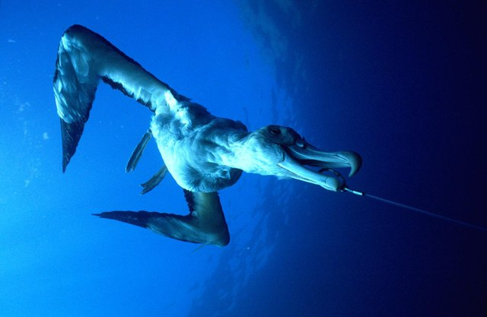
Bycatch
Catch of non-target species
Additional mortality for other species
Often framed for effects on charismatic species
Management Solutions:
Technological
Regulatory limits
Time and area management
Incentive-based

Slide 8
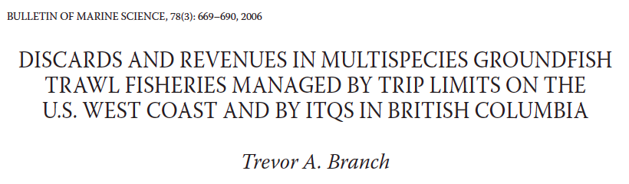
Discarding
Related to bycatch, but discards can also be of target species (e.g. for high-grading).
Not all discards are bycatch, not all bycatch are discards (perhaps this a good thing).
Incentive/regulation programs to promote fishing efficiency.
British Columbia groundfish fishery, no discarding allowed (100% observer coverage). Operators refined targeting to better account for quota holdings / leases

Slide 9
Technical interactions
In a multispecies fishery, fishing for one species means catching others.
“Choke” species where quota for one species constrains ability to reach quota for others.
Quantifying degree of association and likely consequences allows one to quantify tradeoffs
Prevent/Minimize impossible quota setting
Australian SESSF
Minimum bycatch levels based on analysis of shot association data (Klaer and Smith 2008).
Recovering species managed under ‘bycatch’ quota.
Potential problems, fishery could be limited given low biomass species. Rebuilding times prolonged if catch truly unavoidable, OR other sectors impacted.
Need to provide incentives against bycatch quota collecting, allowing targeted fishing.

Slide 10
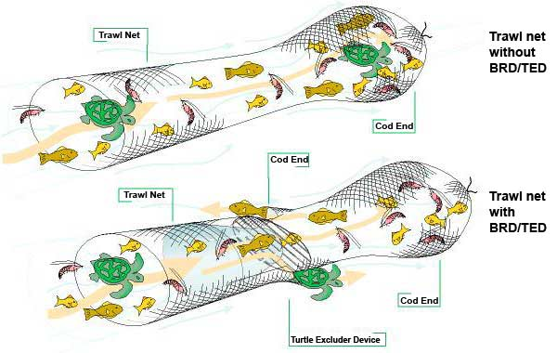
Bycatch: Technological solutions
Physical modifications to fishing gear or fishing process to reduce bycatch, or reduce mortality on bycatch.
e.g. turtle excluder devices, sea lion head rings, seabird stream lines, changes to mesh size, shooters on long lines. Many examples.
Regulations regarding processing at sea, offload of offal, gear type.
Great Barrier Reef Marine Park Authority

Slide 11
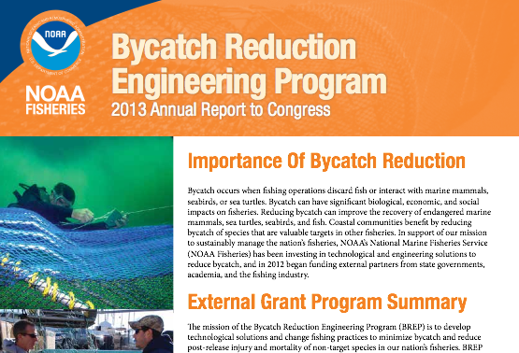
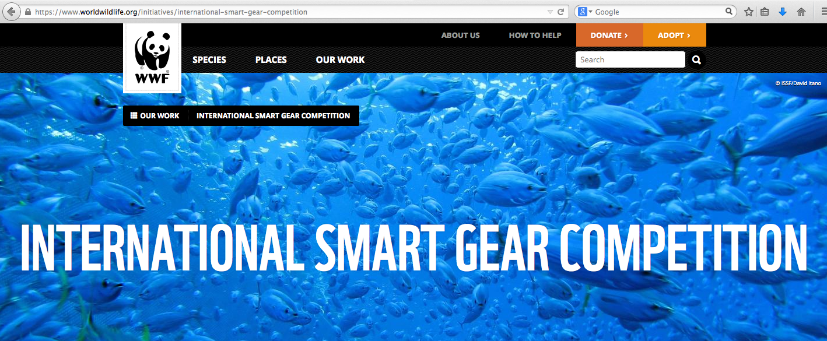
Programs to encourage industry-led solutions

Slide 12
Bycatch: Regulatory limit solutions
Bycatch rate limits (e.g. birds per 1,000 hooks)
Bycatch quotas: once exceeded trigger a change in fishing (e.g. fishing stops, move to new area)
Time-area closures
Quota/effort limitation by increased cost of fishing in areas of high bycatch
e.g. catches of target species from hotspots might count more against quota than areas where bycatch likely to be lower.
What are likely challenges associated with this kind of approach?

Slide 13
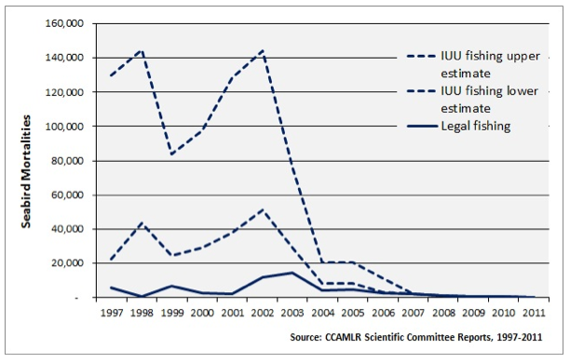
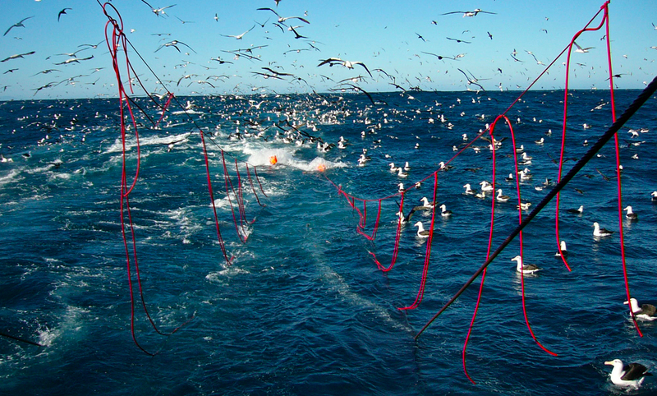
CCAMLR: Mitigating seabird bycatch
MANY mitigation methods aimed at reducing seabird bycatch.
Monitoring responsibilities of CCAMLR observers (200% coverage) – much of time related to seabirds.
Australian fisheries: specific rules of action if seabird struck/caught. Must be followed.
Reporting immediately, move on rules.

Slide 14
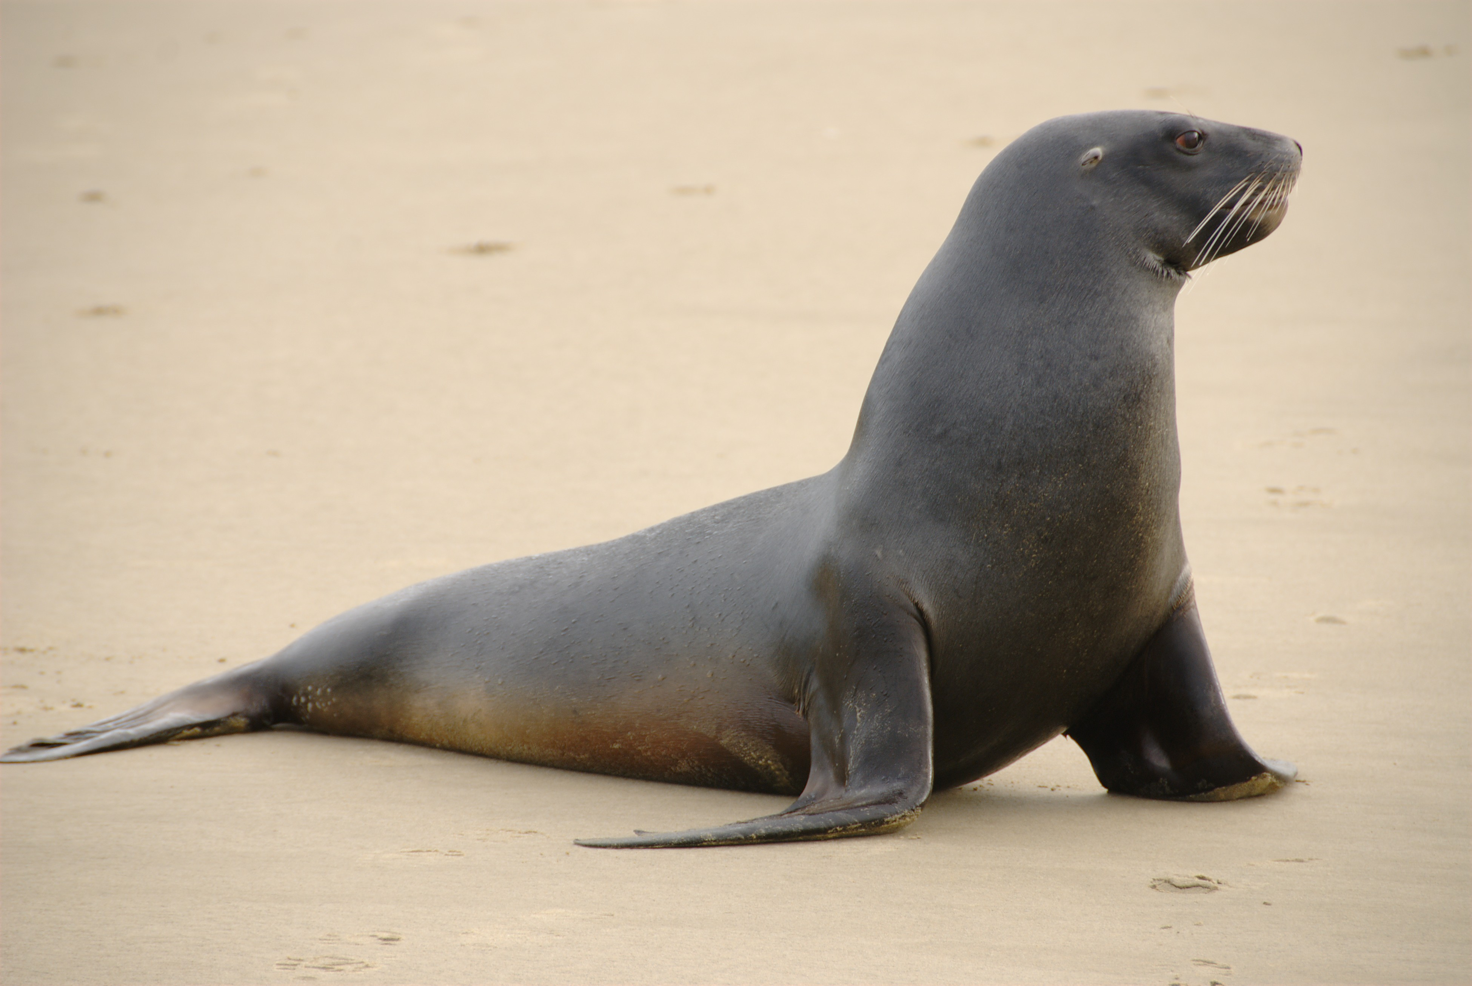
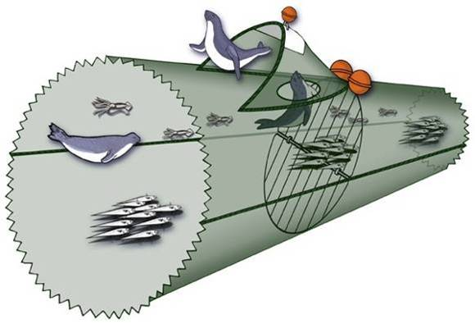
Bycatch – New Zealand sea lion
Use of SLEDs
12 nautical mile limits around rookeries
Mortality limits to implement spatiotemporal closures of trawl fishery
Population viability analysis to assess implications of limits, current bycatch levels

Slide 15
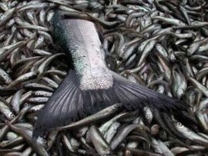
Bering Sea Chinook Salmon bycatch
Pacific salmon caught in walleye pollock fishery.
BIG issue, $$$s and many stakeholders.
Pollock fishery must minimize salmon – total quantity often low, (2-4% impact), but many #s of fish.
Prior to 2011, static time-are closures.
Unable to account for changes in run timing and spatial variability associated with environment conditions.
Current management measures:
Complicated system of caps (or absolute limits on the catch of Chinook in pollock fishery)
Industry designed incentive programmes
Reduce below regulatory level
Reduce bycatch at all levels of salmon abundance

Slide 16
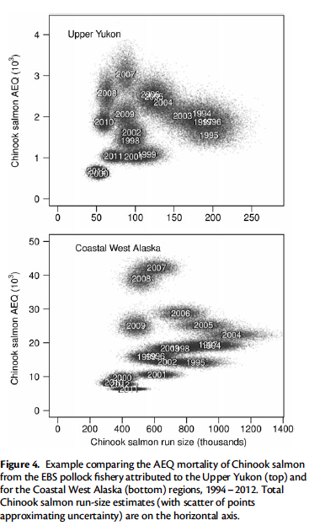
Pollock & salmon
Challenge: mixed stock compositions and uncertainty in salmon run sizes at capture.
Risk assessment models for salmon populations - evaluate likely costs of management action to pollock fishery versus salmon population.

Slide 17
Bycatch: Incentive-based solutions
Tradeable bycatch quota
Lease quota from others if own quota exceeded
Mechanism to prevent fishery closure if unexpected bycatch..
Time-area closures to further minimize likelihood of bycatch (e.g. now little pollock fishing in fall in the Bering Sea)

Slide 18
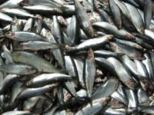
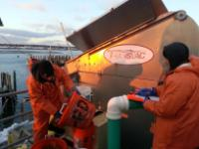
River herring avoidance in the Atlantic herring and mackerel fisheries
Collaborative project between industry, agencies, and academia to reduce bycatch independent of management action.
Provide tool to prevent area closures.
Increase portside sampling
Near real-time information system on location bycatch events
Testing of oceanographic features as indicators of bycatch hotspot areas
Bethoney et al, 2013a,b, 2014

Slide 19
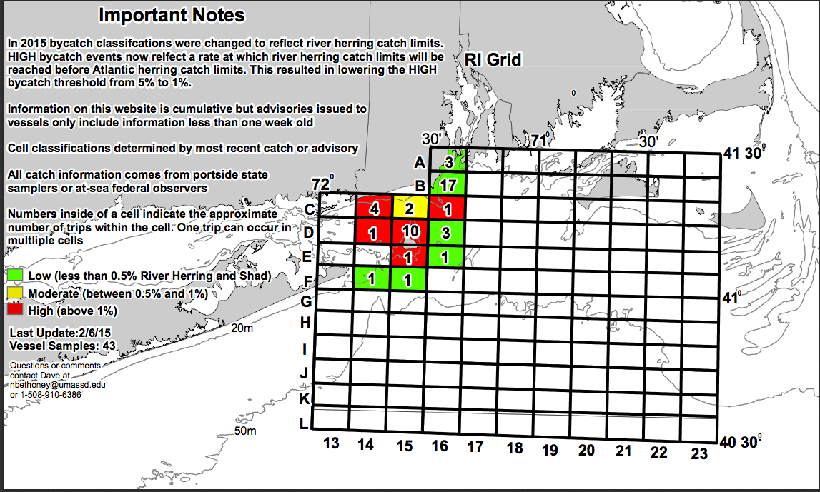
hello

Slide 20
River herring, see also O’Keefe work with Scallops and Yellowtail flounder
Example of cooperative research – fishing industry involved in feasibility study with scientists, see value, potentially more uptake.
Participation often cited as a significant driver of uptake.
Funding streams specifically dedicated to emphasizing industry-based solutions.
More likely to implement if it is own idea.
At the end of the day, bycatch is low effficiency. Fishermen interested in minimizing losses due to inefficiency and broad scale regulation.

Slide 21
Habitat
Effects of fishing on physical habitat
Habitat change effects on fisheries
Including habitat in fisheries management

Slide 22
Benthic effects of fishing on habitat
Damage to benthic habitat
Reduction in benthos
Removal of benthic structure
Dependence of benthic communities
Importance for other species, refuge, reproduction, etc.

Slide 23
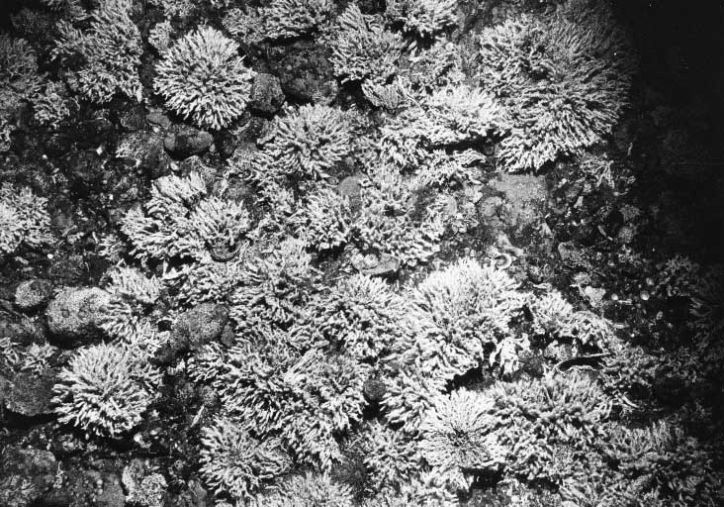
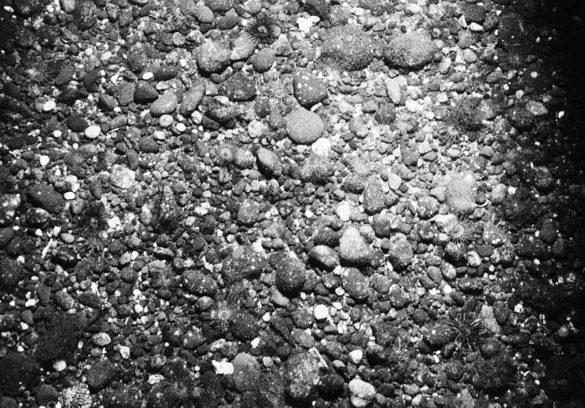
Benthic Habitat Effects
Collie et al. 2000
Notes:
Removal of structure – Fig from Collie paper
Changes in community composition
Sometimes long recovery periods
Indirect effects on fished populations

Slide 24
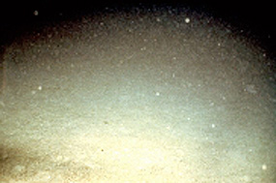
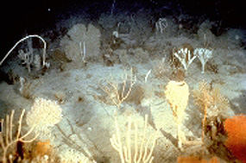
NW Australian Shelf
(Sainsbury et al.)
Demonstrated theoretically and with field data the importance of area closures
Impacts of fishing
Influence of habitat structure on productivity, fish size, etc.
Tropical example
Several subsequent models (we’ll talk about them in a few weeks)

Slide 25
Shifts in habitat
Function of changes in environmental drivers
Long-term and interannual
Changes in species distribution as a function of habitat change
Changes in recruitment with location/extent of habitat.
Climate change: Winners and Losers

Slide 26
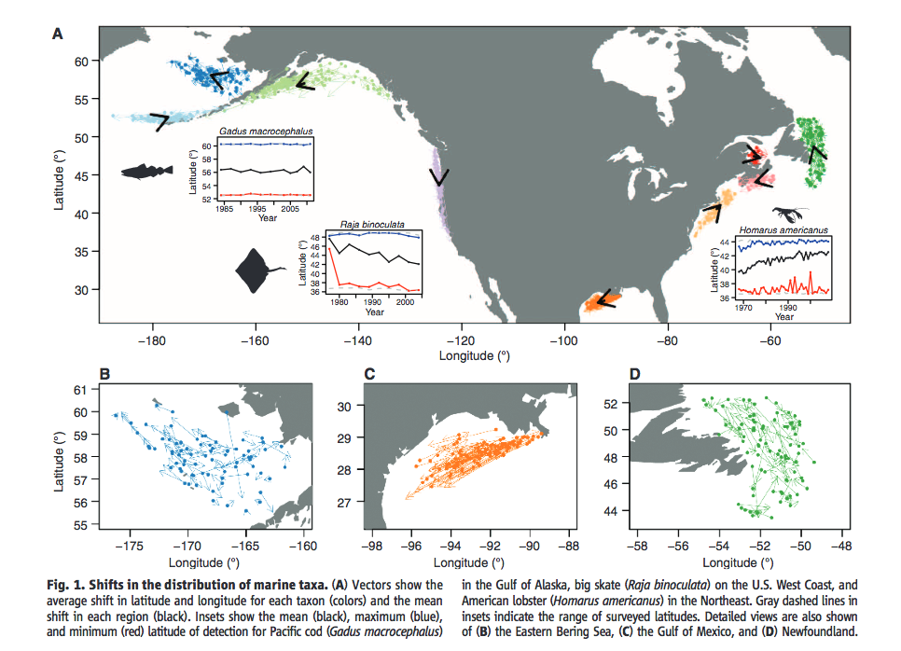
Shifts in distribution of marine species
Pinsky et al. 2013

Slide 27
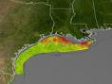
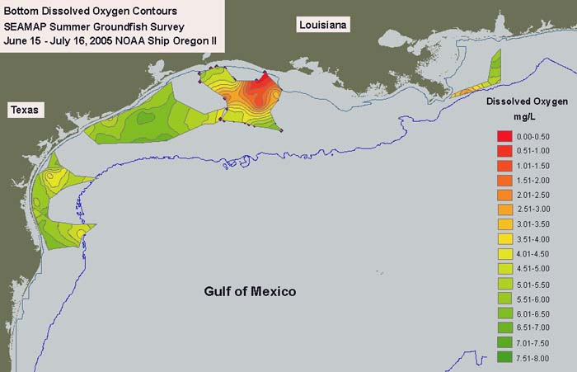
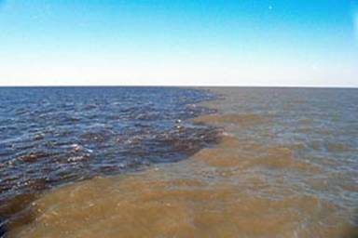
Gulf of Mexico Deadzone
Rabalais et al.
Mississippi River runoff creates a hypoxic zone
This kills fish, causes them to move to sub-optimal habitat, or else causes to move into areas of increased mortality (F&M2)
How to address “upstream” and in GoMex?

Slide 28
Butterfish assessment: thermal pelagic habitat
Butterfish key forage fish in mid-Atlantic.
Spatial distribution appears heavily dependent on temperature profile
Suggests proportion of stock available to the survey changes with habitat
Consequences for estimates of abundance
Habitat now included in catchability term in the stock assessment.
Ongoing work for effects on life history, other species.

Slide 29
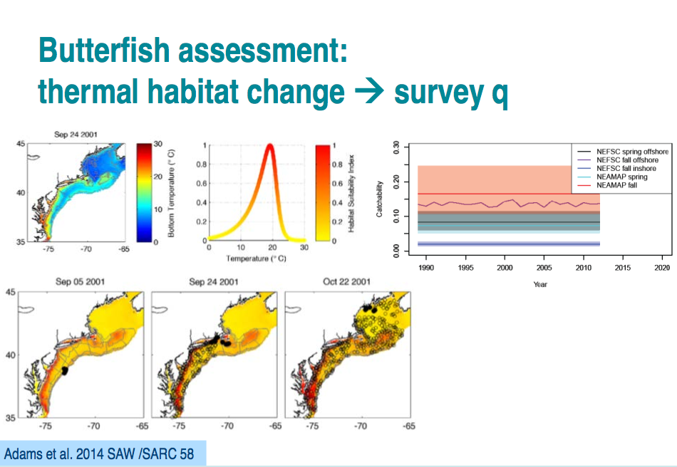
hello

Slide 30
Spatial management

Slide 31
Spatial management
Many management solutions above are related to space.
Many advocate that an ecosystem approach is ‘place-based’.
Reflect importance of locale.
Spatial approaches of course can be implemented without being part of an ecosystem approach.

Slide 32
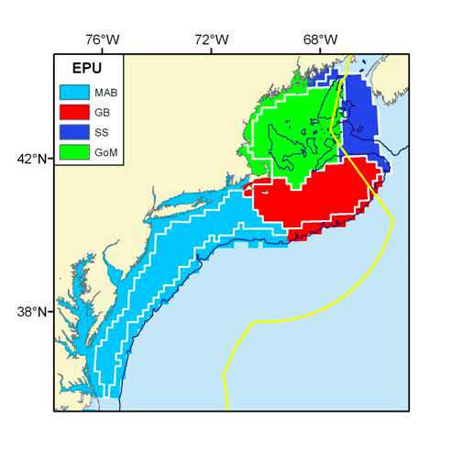
Spatial management: reflecting place
Northeast US ecological production units
Areas are functionally different, species mixes, physical drivers, respond differently.
Perhaps more appropriate units to manage at rather than management boundaries
Butterfish example suggests these should be dynamic?
NEFSC 2012

Slide 33
Spatial closures
Big spectrum of approaches, implemented for many reasons
Time-area closures
Limited entry areas
Marine Protected Areas
Marine Sanctuaries

Slide 34
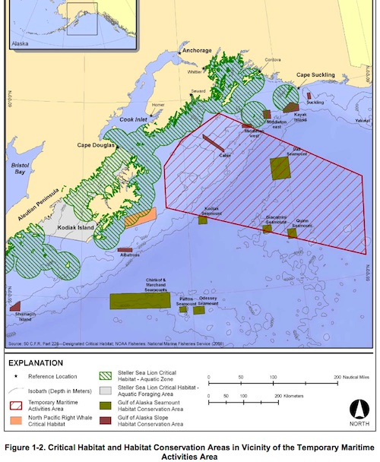
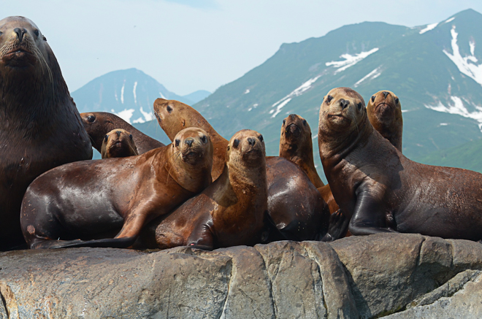
Spatial management for protected species
Area-based fisheries management in the Gulf of Alaska is a very complicated picture.

Slide 35
MPAs (discussion to come) Let’s focus on tradeoffs
What can use of closed areas give us?
Increased biodiversity in reserves
Allow recovery of depleted communities, more big fish
Perhaps good option
Improvements to fisheries due to spillover
This is comonly advocated as an advantage of reserves but been shown to not always be useful.

Slide 36
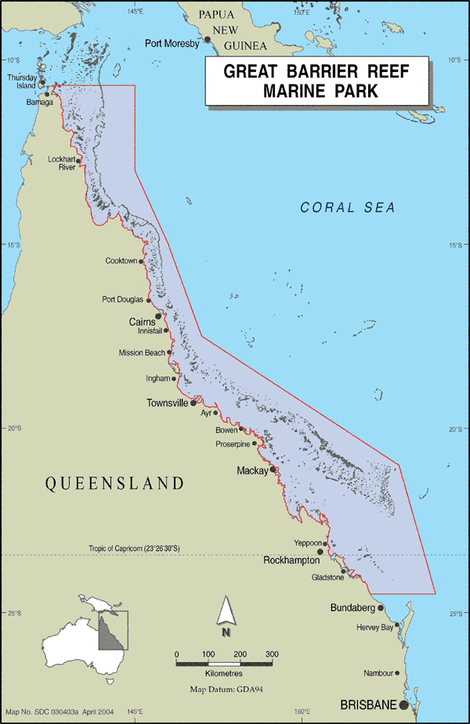
Great Barrier Reef
Multi-use management challenge
Fisheries, recreational opportunities (fishing and biodiversity appreciation)
Siltation, agricultural and freshwater influences
Experiment to determine effects of fishing and of closures as management tool.
A suite of stakeholders, models, and monitoring.
Mapstone et al 2009

Slide 37
Spatial management
Useful management tool
Can be used to address some of the ecosystem effects of fishing
Also provides a way to think at the ecosystem level, with regard to ecosystem structure and function.
Habitat naturally linked to spatial approaches, particularly physical habitat.
Many many examples, including many in coastal environments where tradeoffs among multiple uses expand.

Slide 38
Take home messages
Addressing bycatch and habitat effects can be part of an ecosystem approach.
Successful solutions often involve cooperative approaches to research and management.
Enforcement challenges
Spatial management can be a useful tool
Need to evaluate tradeoffs against objectives
What do you get by spending lots of $ on expensive solutions?
What are the incentives to comply?
What are the losses in (fisheries) yield?
What are gains/changes in natural capital?
What are the indirect effects, do these need to be thought about in an EBFM context?

Slide 39
Doing EBFM
Questions?

Slide 40
What’s Next?
Ecosystem indicators
Discussion on:
Link 2005
Hall and Mainprize 2004
Jennings 2005
Halpern et al. 2012

